Slide 1
Lab1 Background: Socket Programming with UDP and TCP
Notes:
here we go okay okay so this is cs168 second
0:29
lecture all about the internet design principles so to start off with today I
0:36
just want to set the stage for what today's all about last time we showed you how the internet was built we told
0:41
you things like here are some layers and layer three provides best effort and
0:46
routers understand the first three layers and end hosts understand all five layers so we kind of just told you that
0:54
this is how the internet was built and you trusted us that was how the internet's built and everything was
0:59
great so today's question is not how but why why did we make all those choices who
1:05
was it that decided that layer three is all about best effort and that there are no reliability guarantees at layer three
1:12
who was it that decided that there are these five layers and that they're built in this particular way and are there
1:18
other ways that we could have designed the internet

Slide 2
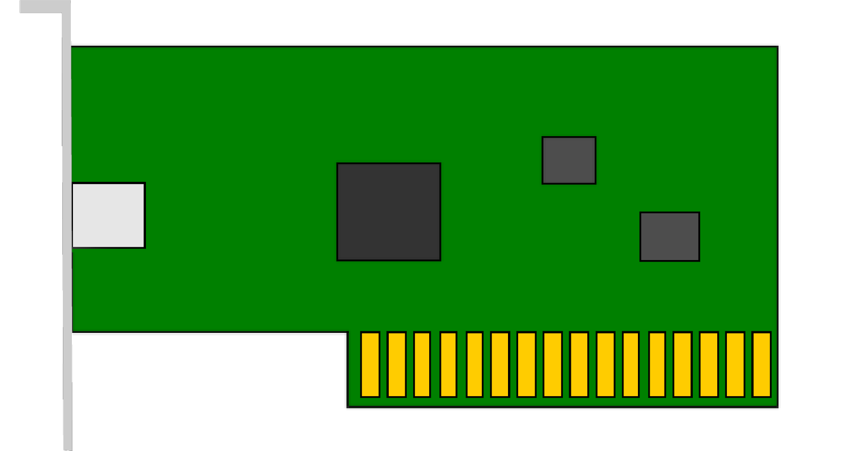
Sockets
Endpoint for sending or receiving data across a network
OS abstraction for connections
Allow L7 applications to operate on data streams (not packets)
Connect, listen, accept, send, receive
Open a socket between:
Source IP address : port
Destination IP address : port
app
app
app
Application
Port
Transport
Network
OS
(networking stack)
Datalink
Physical
NIC
(Network Interface Card)

Slide 3
Connection (the basic abstraction)
Pipes data between two processes (on different hosts)
Data flows both ways
Data is sent as a stream of bits
Reconstruction of bits only at the endpoints
Process
Process
Process
Process
The Internet
Process
Process
Process
Process
Connection

Slide 4
Connections
Two types of sockets
Server and Client
Servers listen for clients to connect to them
Wait until a connection is attempted
Accept and dispatch connection
Usually serving many clients at once
Clients initiate new connections to servers
Example
Server: www.hofstra.edu
Client: Your internet browser
Client
Client
Server
Client
Client

Slide 5
Connections
Hosts have addresses
Unique identifier (just like a street address)
Clients (different users) find servers with their addresses
Servers send data back with the client address
IP addresses are not enough
Also need ports
1.2.3.4
5.6.7.8
Client
Client
10.20.30.40
Server
9.10.11.12
13.14.15.16
Client
Client
Notes:
Are addresses enough to make this work?

Slide 6
Ports
Sockets are identified by unique IP:port pairs
A port is a number associated with a socket when it is created
i.e. sending to address “1.2.3.4:10000” would send data to the socket owned by Process 1
Each server listens on a well-known port
Which one depends on application
HTTP: 80
SSH: 22
Client also has a port
Port number can be any (large) number
Server Machine
Client Machine (1.2.3.4)
Process 1
(Port 80)
Process 1
(Port 10000)
Process 2
(Port 20000)
Notes:
Packets carry port number Client process connects to
well known port

Slide 7

Socket programming
IMPORTANT
goal: learn how to build client/server applications that communicate using sockets
socket: door between application process and end-end-transport protocol
application
socket
application
controlled by
app developer
process
process
transport
transport
network
network
controlled
by OS
link
Internet
link
physical
physical

Slide 8
Socket programming
IMPORTANT
Two socket types for two transport services:
UDP: unreliable datagram
TCP: reliable, byte stream-oriented
Application Example:
client reads a line of characters (data) from its keyboard and sends data to server
server receives the data and converts characters to uppercase
server sends modified data to client
client receives modified data and displays line on its screen

Slide 9
Socket programming with UDP
IMPORTANT
UDP: no “connection” between client and server:
no handshaking before sending data
sender explicitly attaches IP destination address and port # to each packet
receiver extracts sender IP address and port# from received packet
UDP: transmitted data may be lost or received out-of-order
Application viewpoint:
UDP provides unreliable transfer of groups of bytes (“datagrams”) between client and server processes

Slide 10
Client/server socket interaction: UDP
IMPORTANT
server (running on serverIP)
client
create socket:
create socket, port= x:
clientSocket =
socket(AF_INET,SOCK_DGRAM)
serverSocket =
socket(AF_INET,SOCK_DGRAM)
Create datagram with serverIP address
And port=x; send datagram via clientSocket
read datagram from
serverSocket
write reply to
serverSocket
specifying client address,
port number
read datagram from
clientSocket
close
clientSocket

Slide 11
Example app: UDP client
IMPORTANT
Python UDPClient
include Python’s socket library
from socket import *
serverName = 'hostname'
serverPort = 12000
clientSocket = socket(AF_INET,
SOCK_DGRAM)
message = input('Input lowercase sentence:')
clientSocket.sendto(message.encode(),
(serverName, serverPort))
modifiedMessage, serverAddress =
clientSocket.recvfrom(2048)
print(modifiedMessage.decode())
clientSocket.close()
create UDP socket
get user keyboard input
attach server name, port to message; send into socket
read reply data (bytes) from socket
print out received string and close socket
Note: this code update (2023) to Python 3
Notes:
UDO and TCP code updates 3/23

Slide 12
Example app: UDP server
IMPORTANT
Python UDPServer
from socket import *
serverPort = 12000
serverSocket = socket(AF_INET, SOCK_DGRAM)
serverSocket.bind(('', serverPort))
print('The server is ready to receive')
while True:
message, clientAddress = serverSocket.recvfrom(2048)
modifiedMessage = message.decode().upper()
serverSocket.sendto(modifiedMessage.encode(),
clientAddress)
create UDP socket
bind socket to local port number 12000
loop forever
Read from UDP socket into message, getting client’s address (client IP and port)
send upper case string back to this client
Note: this code update (2023) to Python 3

Slide 13
Socket programming with TCP
IMPORTANT
Client must contact server
server process must first be running
server must have created socket (door) that welcomes client’s contact
Client contacts server by:
Creating TCP socket, specifying IP address, port number of server process
when client creates socket: client TCP establishes connection to server TCP
when contacted by client, server TCP creates new socket for server process to communicate with that particular client
allows server to talk with multiple clients
client source port # and IP address used to distinguish clients (more in Chap 3)
Application viewpoint
TCP provides reliable, in-order
byte-stream transfer (“pipe”)
between client and server processes

Slide 14
Client/server socket interaction: TCP
IMPORTANT
server (running on hostid)
client
create socket,
port=x, for incoming request:
serverSocket = socket()
wait for incoming
connection request
TCP
connection setup
create socket,
connect to hostid, port=x
connectionSocket =
serverSocket.accept()
clientSocket = socket()
send request using
clientSocket
read request from
connectionSocket
write reply to
connectionSocket
read reply from
clientSocket
close
connectionSocket
close
clientSocket

Slide 15
Example app: TCP client
IMPORTANT
Python TCPClient
from socket import *
serverName = 'servername'
serverPort = 12000
clientSocket = socket(AF_INET, SOCK_STREAM)
clientSocket.connect((serverName,serverPort))
sentence = input('Input lowercase sentence:')
clientSocket.send(sentence.encode())
modifiedSentence = clientSocket.recv(1024)
print ('From Server:', modifiedSentence.decode())
clientSocket.close()
create TCP socket for server, remote port 12000
No need to attach server name, port
Note: this code update (2023) to Python 3

Slide 16
Example app: TCP server
IMPORTANT
Python TCPServer
from socket import *
serverPort = 12000
serverSocket = socket(AF_INET,SOCK_STREAM)
serverSocket.bind(('',serverPort))
serverSocket.listen(1)
print('The server is ready to receive')
while True:
connectionSocket, addr = serverSocket.accept()
sentence = connectionSocket.recv(1024).decode()
capitalizedSentence = sentence.upper()
connectionSocket.send(capitalizedSentence.
encode())
connectionSocket.close()
create TCP welcoming socket
server begins listening for incoming TCP requests
loop forever
server waits on accept() for incoming requests, new socket created on return
read bytes from socket (but not address as in UDP)
close connection to this client (but not welcoming socket)
Note: this code update (2023) to Python 3

